Slide 1
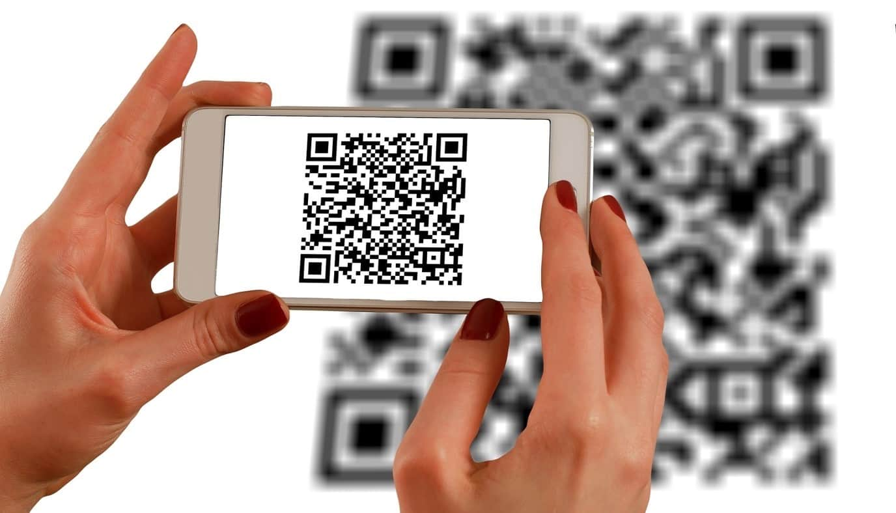

Slide 2
QR CODE BASED HALL TICKET
LRG GOVERNMENT ARTS COLLEGE FOR WOMEN
PRESENTED BY:S.DIVYA
IIIBSC COMPUTER SCIENCE
GUIDED BY DR. SUGANTHI

Slide 3
OUTLINE
ABSTRACT
OBJECTIVE
HARDWARE SPECIFICATION
SOFTWARE SPECIFICATION
EXISTING SYSTEM
PROPOSING SYSTEM
MODULES
DATA FLOW DIAGRAM

Slide 4
ABSTRACT
The project entitled as “QR Code Based Hall ticket System” has developed using JAVA as front end and My SQL server as back end.
This project is being created to decrease the effort of human and forgery in hall tickets in the educational institutes. The hall ticket is fully based on the Quick Response (QR) code, which is a new embedding technique.
This project is the pure automated solution and it will help to generate student hall ticket easily. It is a special type of software which will be used to make a secure hall ticket with QR code instead of the bar code
In current scenario, educational institutes have different types of examinations. For all these they need to distribute hall ticket. In the existing system, there are printed hall tickets are used. So any one can forge and make malpractice over the printed copies.

Slide 5
The main aim of this project to generate unique QR code for students’ hall tickets. This helps to keep the data secret. Using the QR reader/scanner the hall ticket information’s can be extracted. Using this application, the admin can generate hall ticket for individual students; this will be transferred via email.
The students can take printout of these QR codes at the time of examination. In this automated system the hall ticket and results data generation process is completely done by the computer with the help of the software

Slide 6
OBJECTIVE
The main aim of this application is"To provide security Without exposing personal details ".

Slide 7
HARDWARE SPECFICATION
Processor : P 4 700 GHz.
RAM : 4 GB RAM
Hard Disk Drive : 180 GB

Slide 8
SOFTWARE SPECIFICATION
Operating System : Windows 7/8/10
Front End : JAVA
Back End : MYSQL

Slide 9
EXISTING SYSTEM
The existing system of hall ticket the student should taken the hall ticket before reaching the exam hall. If student might be forget to took the hall ticket before the exam hall or before leaving from home it may cause unnecessary problem. We can avoid this issue using our digitalized hall ticket.
DISADVANTAGES
Virtual hall ticket chance for lost or broke the ticket.
Its not comfortable on pressure situation.
Need to spend money to print the hall ticket.

Slide 10
PROPOSED SYSTEM
Our system to be modify the hall ticket generation as an digitalized. The teacher can scan using some third party application to scan the QR code. The QR code will be showing the details of the student and then teacher can verify the details.
ADVANTAGES
No need to carry the ticket in hand
No need to handle safely because of its digitalized
Avoid the cost of the hall ticket

Slide 11
Modules
Teacher / Admin Login
Teacher or Admin has the login credential and they have to be login in to this application. For the security reason they should login and access this application. The login details are stored in a database when the admin or teacher trying to login it can refer from the login table.
Student Registration
The college staff only able to register the student details, before that they should collect all the information from the student and they can register. This details are stored in a student table. Once the details are stored then student have own access to login into this application.
Hall Ticket Registration
After the student registration have been completed, the admin registered the hall ticket details. This record will be stored in to the hall ticket table. Once the ticket has been registered then the QR code has been generated.

Slide 12
QR Code Generation
QR Code will be generated and viewed into the server, when student login into the application it will can show into the hall ticket details screen.
Student Login
Once the student registration has been completed, then they have unique username and password. Which fields are collect the information from the student table. If the username or password is incorrect, we won’t allow to enter into the application.
View Hall Ticket
Student can able to view the hall ticket as a QR code. When student reached the exam hall the teachers scanning the QR code view the student details accordingly.

Slide 13

Data Flow Diagram
Level 0 :

Slide 14
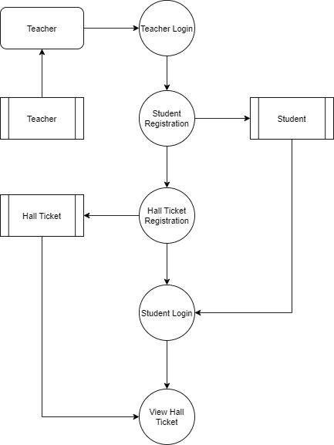
Level 1:

Slide 15
TABLE DESIGN TABLE NAME:Teacher
FIELD | DATA TYPE | SIZE | CONSTRAINT
Admin id | Int | 10 | Primary key
Username | Varchar | 30 | Not null
password | Varchar | 30 | Not null

Slide 16
TABLE NAME:Hall Ticket
FIELD | DATA TYPE | SIZE | CONSTRAINT
Hall Ticket id | Int | 10 | Primary key
Student Id | Int | 10 | Foreign Key
Hall No | Varchar | 10 | Not null
Exam Date | Date | 10 | Not null

Slide 17
TABLE NAME:Student
FIELD | DATA TYPE | SIZE | CONSTRAINT
Student id | Int | 10 | Primary key
Firstname | Varchar | 20 | Not null
Lastname | Varchar | 5 | Not null
Roll No | Int | 10 | Not null
Department | Int | 20 | Not null
Class name | Varchar | 20 | Not null
Username | Int | 15 | Not null
Password | Varchar | 7 | Not null

Slide 18
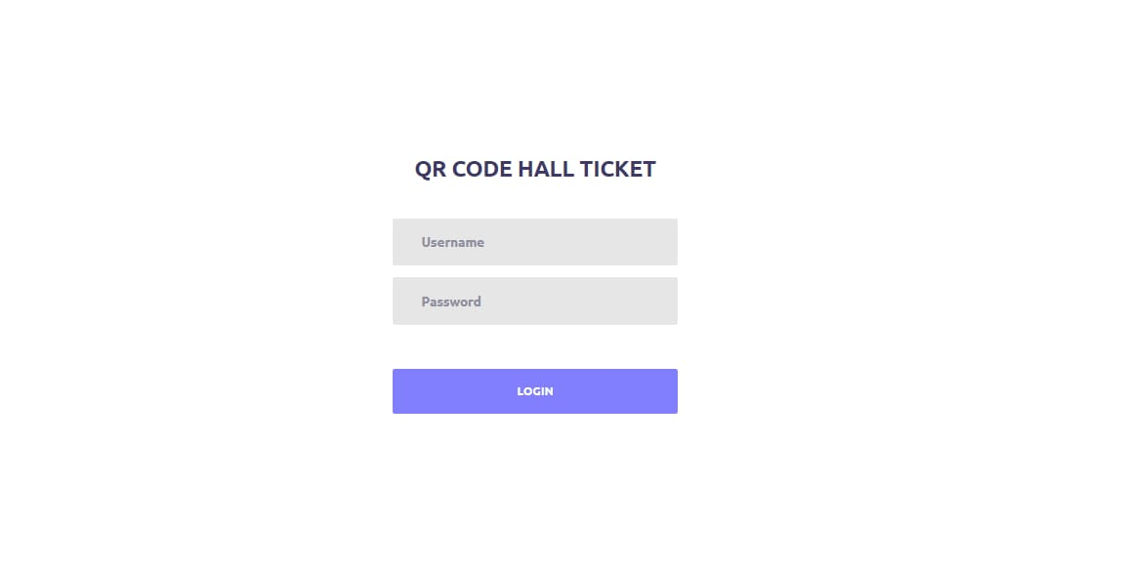
FORM DESIGN

Slide 19
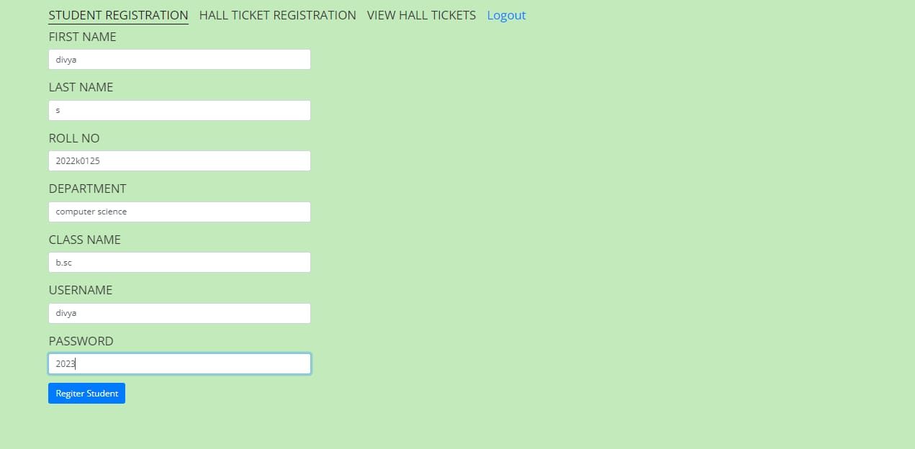

Slide 20
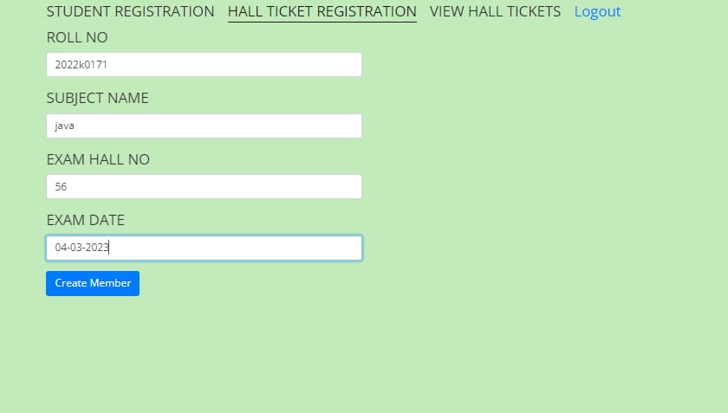

Slide 21
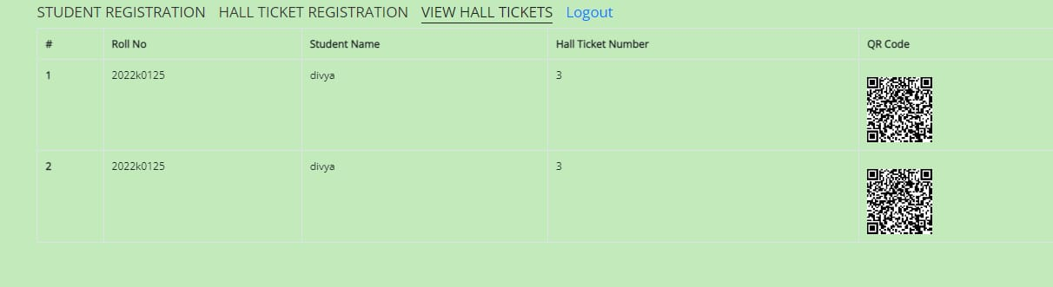

Slide 22
Thank You

